Slide 1
Objective
Characterise relationships between zooplankton size-spectra metrics and environmental variables using statistical models
Place results from part 1 in context of oceanographic processes,
by qualitative inference on the state of the EAC & upwelling, and potential influence of these on zooplankton

Slide 2
Part 1: Data and proposed approach
OPC (4 sites, in spring 2004)
4 x zooplankton SS metrics*
Temperature *
Salinity*
Sample depth*
4 response variables -> 4 sets of analyses:
Biomass
ESD
SS slope
Abundance
ADCP (4 sites)
U* and V*
GAM
BRT
Hydrology (3 sites)
Nitrate*, phosphate*, silicate*
Candidate explanatory variables
CTD (3 sites)
DO*
Fluorescence*
Other
Site/wind stress/latitude*
Distance from shore*
Seafloor depth (GA Australia)*
Seafloor slope (8 neighbouring cells)*

Slide 3
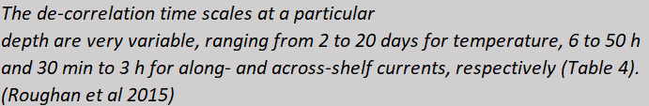
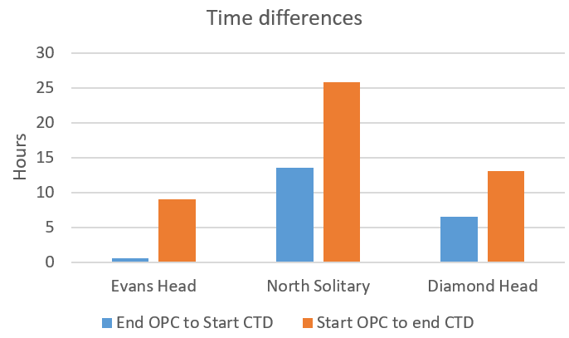
Temporal overlap between data sources (OPC and CTD/HYD)
Temperature
Ok because I’m filtering ADCP data points to those collected during OPC tow
Along shelf currents
Across shelf currents

Slide 4
Spatial overlap between data sources
Spatial decorrelation scales
Fluorescence horizontal: 5-10km
Fluorescence vertical: 45m
Temperature and DO along shelf: 28-37km
Temperature and DO across shelf: 8-19km
Salinity: 10-15km

Slide 5
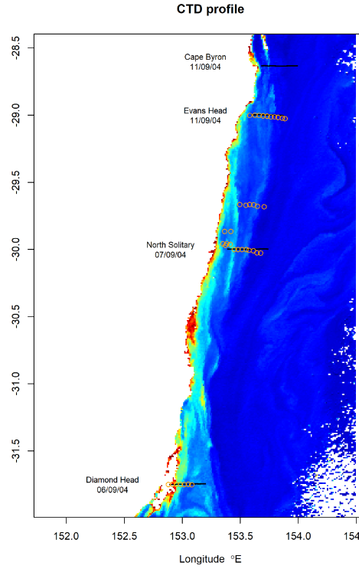
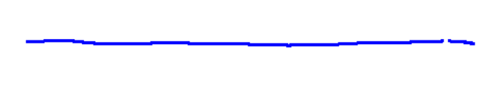
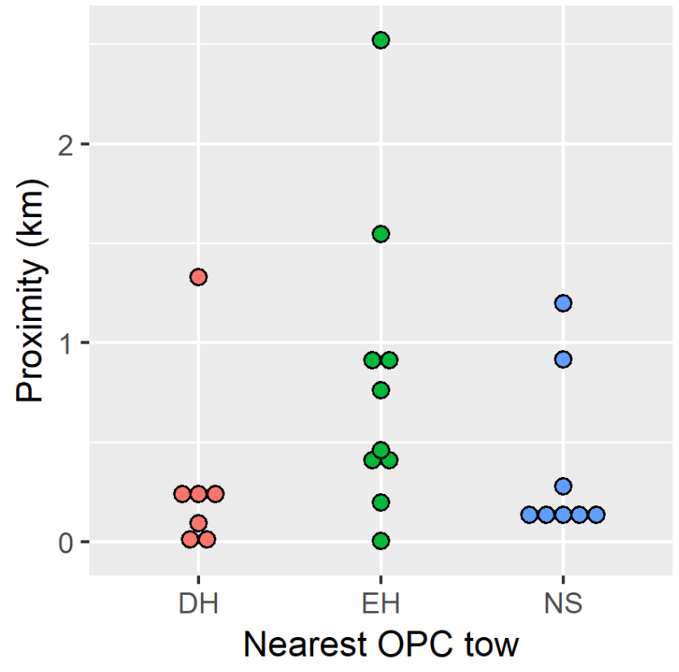
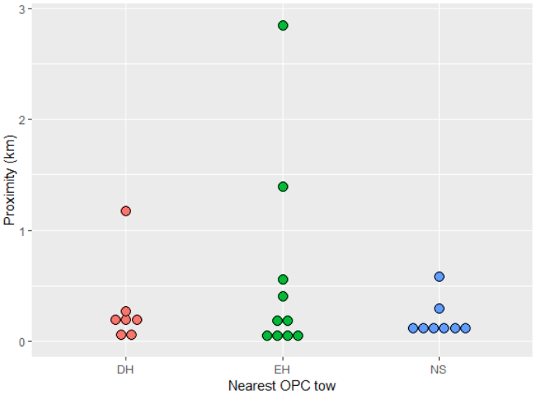
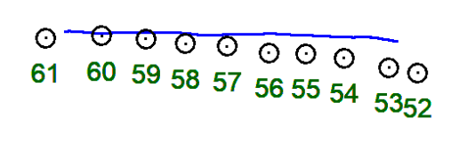
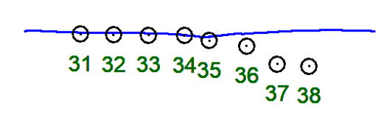
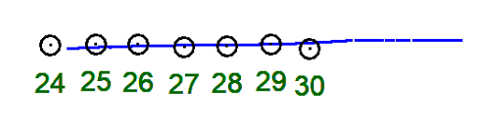
Spatial overlap between data sources

Slide 6
Hydrology

Slide 7

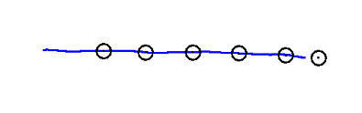
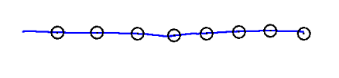

ADCP
(ADCP data collected concurrently with OPC tow)

Slide 8
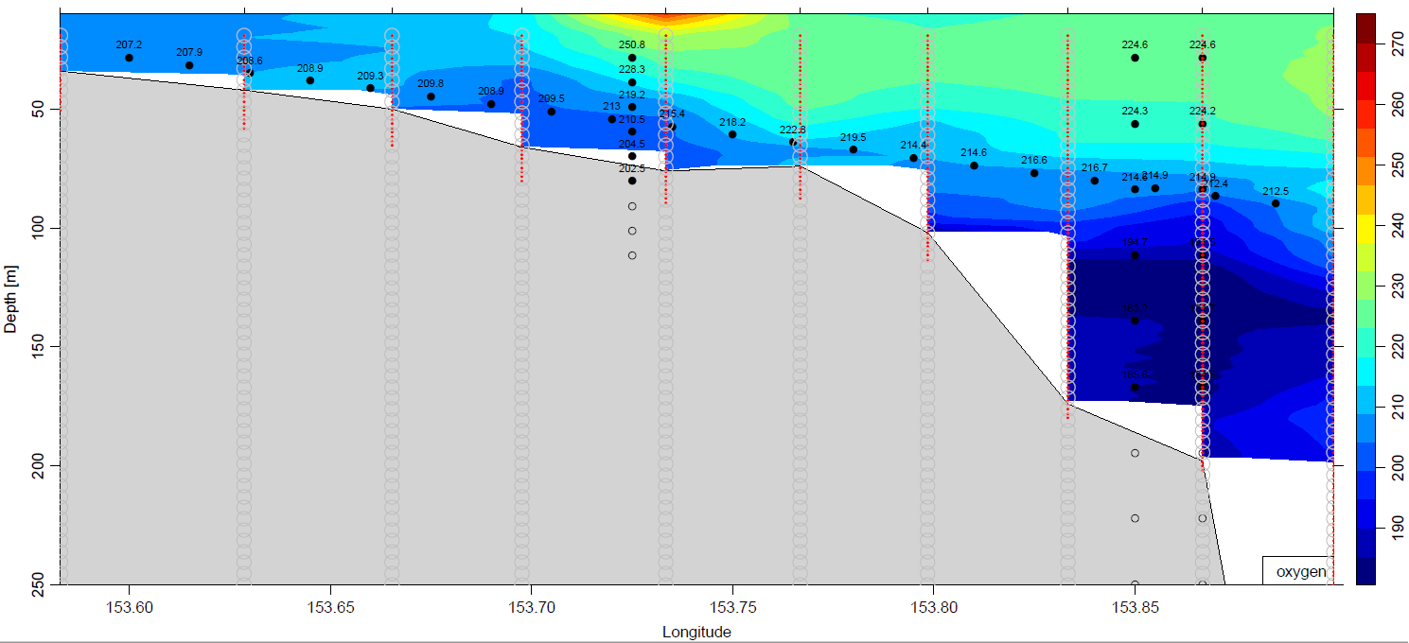
CTD interpolation: Oxygen (5m vertical interpolation)

Slide 9
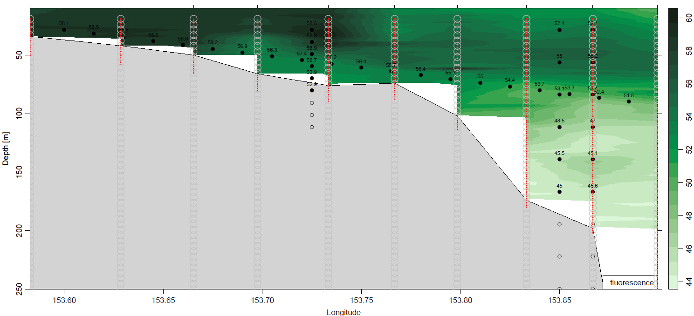
CTD interpolation: Fluorescence (5m vertical interpolation)

Slide 10
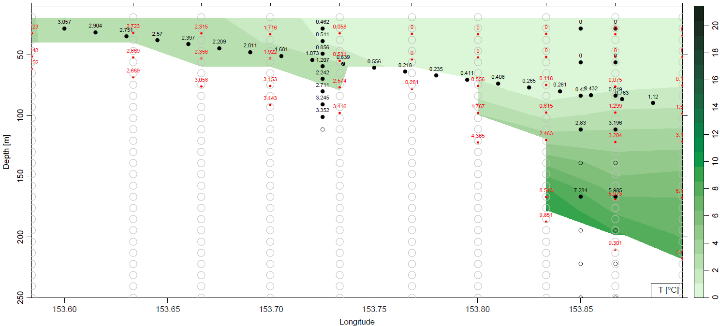
Hydrology interpolation: Nitrate (10m vertical interpolation)

Slide 11
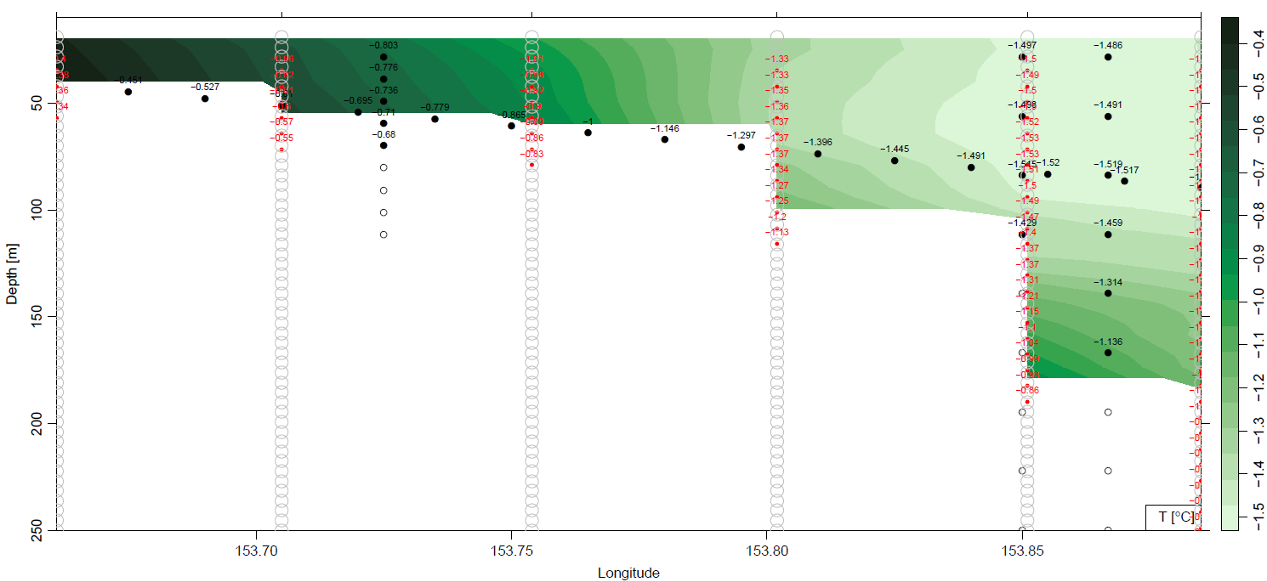
ADCP interpolation: V (10m vertical interpolation)

Slide 12
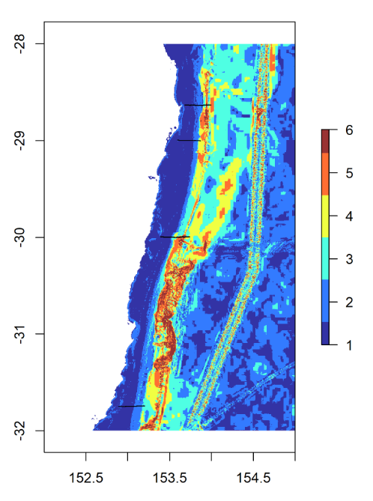
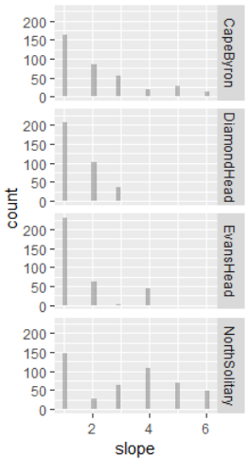
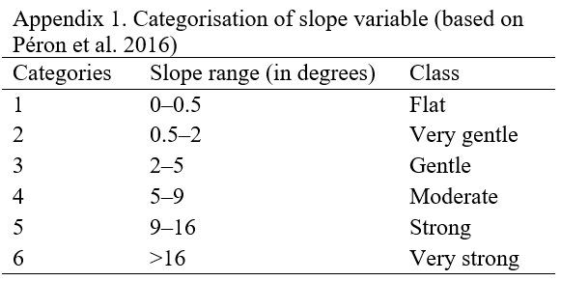
Slope

Slide 13
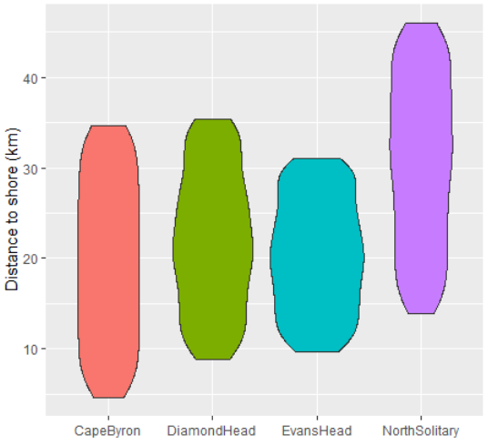
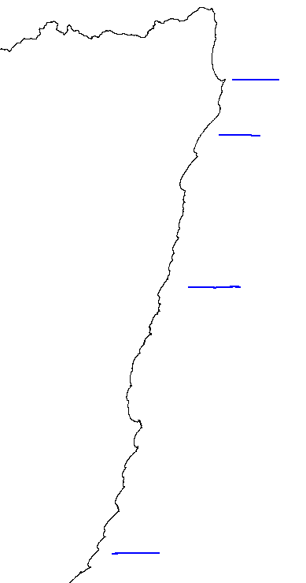
Distance to Coast

Slide 14
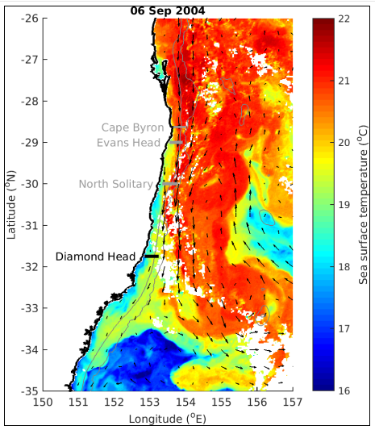
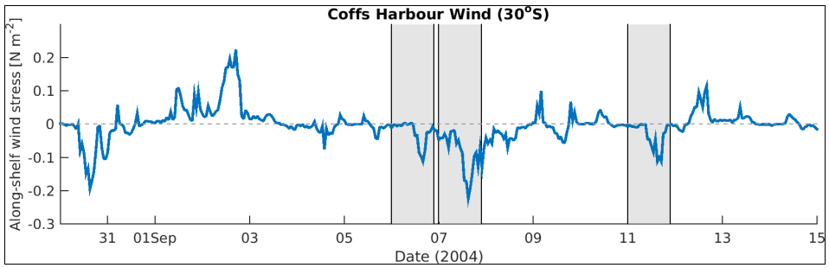
Part 2: characterising oceanography
DH on Sep 6: is not really affected by the EAC (which is more offshore and starting to separate from the coast). The cold water on the coast is most likely due to the upwelling the same days but it's relatively weak.

Slide 15
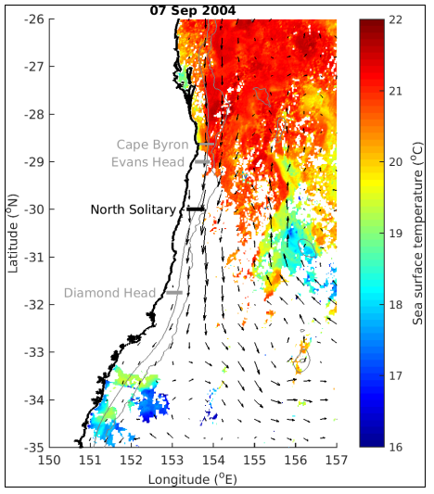
Part 2: characterising oceanography
NS on 7th: there you sampled the coastal water and the edge of the EAC. Another upwelling day.

Slide 16
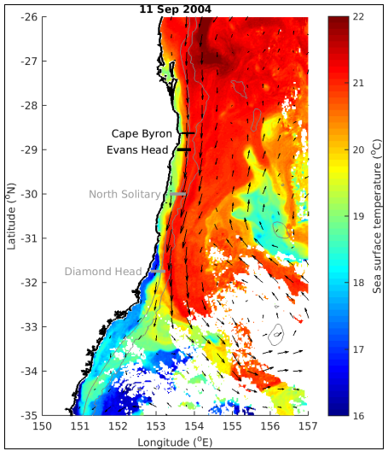
Part 2: characterising oceanography
CP and EH on the 11th: the profile looks like an upwelling. Here I would say that you have a mix of EAC driven and wind-driven upwelling.

Slide 17
Questions
Lag to account for OPC cable length?
Are coords in OPC data the vessel or the seasoar?
How does that relate to the position of ship-mounted ADCP and vertical CTD profiles?
All good, not a worry ☺

